Slide 1
Building HTTP RESTful Services with ASP.Net Web API
Venkat Shiva Reddy

Slide 2
Learning Web API : Pre-requisits
.Net Framework 4.0 or later
ASP.Net MVC 5.0
Developing SOA Applications
**Knowledge of Web Services & WCF Services
HTTP, HTML, JavaScript / jQuery

Slide 3
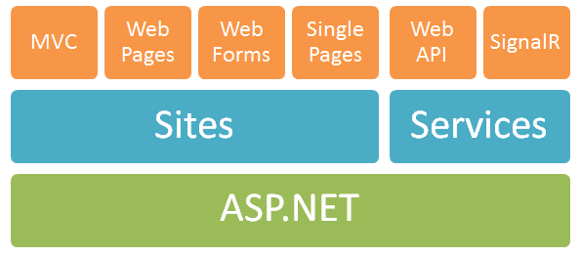
One ASP.Net – An Overview
One ASP.Net Vision

Slide 4
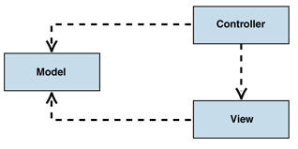
One ASP.Net - MVC
The Model-View-Controller (MVC) pattern separates the modeling of the domain, the presentation, and the actions based on user input into three separate classes

Slide 5

One ASP.Net – Web Pages
Processed at client
Uses HTML + JavaScript + CSS + jQuery

Slide 6
One ASP.Net – Web Forms
Processed at Server
Uses Server Side Code (C#, Server Controls…)

Slide 7
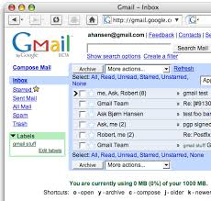
One ASP.Net – Single Pages
A single-page application (SPA), also known as single-page interface (SPI), is a web application or web site that fits on a single web page with the goal of providing a more fluid user experience akin to a desktop application.

Slide 8
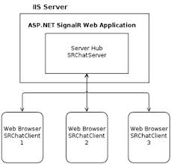
One ASP.Net - SignalR
Real-Time Web App’s
It's the ability to have your server-side code push content to the connected clients as it happens, in real-time.

Slide 9
One ASP.Net – Web API
ASP.NET Web API is a framework that makes it easy to build HTTP services that reach a broad range of clients, including browsers and mobile devices.
ASP.NET Web API is an ideal platform for building RESTful applications on the .NET Framework.

Slide 10
What is Service?
Service – A service is a unit of work done by a service provider to achieve desired end results for a service consumer

Slide 11
Evolution of Distributed Computing
Web Svcs.
Remoting
.NET
COM+
Win2000
Prog.
Model
COM
MTS
WinNT
OLE
DDE
Win 3.1
Time

Slide 12





Distributed Technologies in .NET 2.0
System.
Messaging
.NET
Remoting
Enterprise
Services
ASMX
WSE

Slide 13
Distributed Technology Choices
No
Is it
.NET to .NET?
Yes
No
Need
Extensibility?
Yes
Select
Web Services
Select
Remoting
Select
Ent. Services
No
Is there a
Firewall?
Yes
Select TCP
Select HTTP

Slide 14

WCF Unification
 | ASMX | Remoting | Ent. Svc | WSE | MSMQ | WCF
Interoperable Web Services
.NET – .NET Communication
Distributed Transactions, etc.
Support for WS-* Specs
Queued Messaging

Slide 15
Web Services?
It is based on SOAP and return data in XML form.
It support only HTTP protocol.
It is not open source but can be consumed by any client that understands xml.
It can be hosted only on IIS.

Slide 16
WCF?
It is also based on SOAP and return data in XML form.
It is the evolution of the web service(ASMX) and support various protocols like TCP, HTTP, HTTPS, Named Pipes, MSMQ.
The main issue with WCF is, its tedious and extensive configuration.
It is not open source but can be consumed by any client that understands xml.
It can be hosted with in the application or on IIS or using window service.

Slide 17
WCF REST?
To use WCF as WCF Rest service you have to enable webHttpBindings.
It support HTTP GET and POST verbs by [WebGet] and [WebInvoke] attributes respectively.
To enable other HTTP verbs you have to do some configuration in IIS to accept request of that particular verb on .svc files
Passing data through parameters using a WebGet needs configuration. The UriTemplate must be specified
It support XML, JSON and ATOM data format.

Slide 18
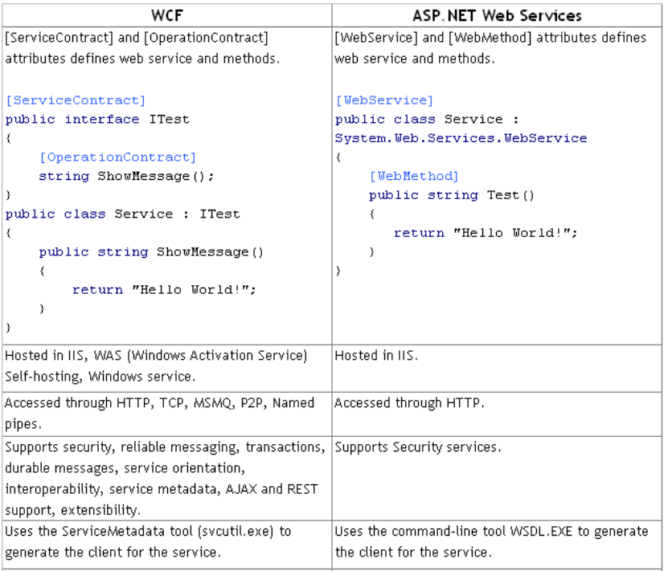
WCF v/s Web Services

Slide 19
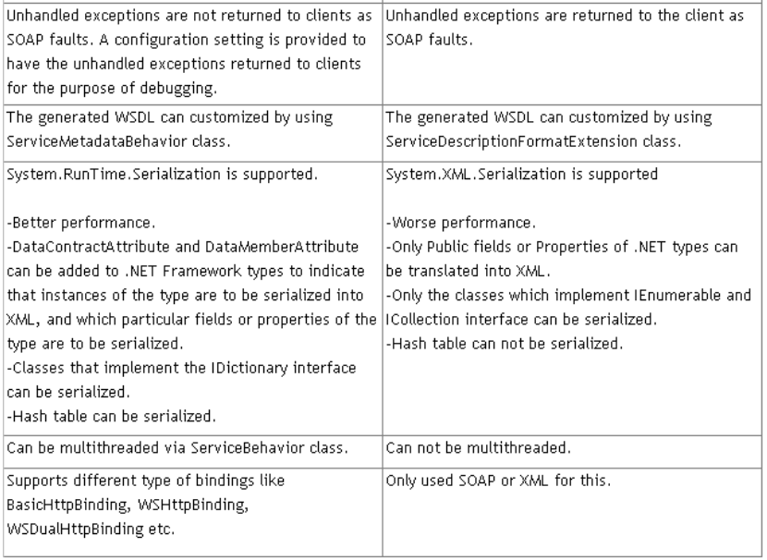
WCF v/s Web Services

Slide 20
Web API?
This is the new framework for building HTTP services with easy and simple way.
Web API is open source an ideal platform for building REST-ful services over the .NET Framework.
Unlike WCF Rest service, it use the full features of HTTP (like URIs, request/response headers, caching, versioning, various content formats)
It also supports the MVC features such as routing, controllers, action results, filter, model binders, IOC container or dependency injection, unit testing that makes it more simple and robust.
It can be hosted with in the application or on IIS.
It is light weight architecture and good for devices which have limited bandwidth like smart phones.
Responses are formatted by Web API’s MediaTypeFormatter into JSON, XML or whatever format you want to add as a MediaTypeFormatter.

Slide 21
*WCF Rest + *MVC = Web API
WCF Rest
MVC
Web API
Routing + Controllers + Actions + Filters + Model Binding
URIs, request/response headers, caching, versioning, various content formats
HTTP Verbs + JSON

Slide 22
To whom choose between WCF or WEB API?
WCF
Choose WCF when you want to create a service that should support special scenarios such as one way messaging, message queues, duplex communication etc.
Web API
Choose Web API when you want to create a resource-oriented services over HTTP that can use the full features of HTTP (like URIs, request/response headers, caching, versioning, various content formats).
Choose WCF when you want to create a service that can use fast transport channels when available, such as TCP, Named Pipes, or maybe even UDP (in WCF 4.5), and you also want to support HTTP when all other transport channels are unavailable.
Choose Web API when you want to expose your service to a broad range of clients including browsers, mobiles, iphone and tablets.

Slide 23
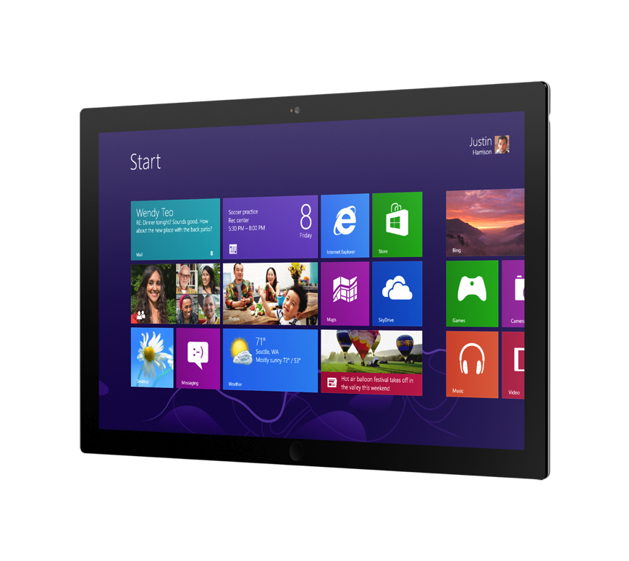


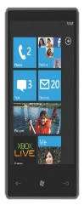



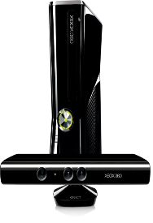





How to reach more clients?
App
?
?
?
?
Browsers
Devices
Phones
Tablets

Slide 24
How to make it scale?
App
?
?
?
?
Browsers
Devices
Phones
Tablets

Slide 25
Leverage the web – build Web APIs
App
Web API
Browsers
Devices
Phones
Tablets

Slide 26
What is a Web API?
An HTTP service
Designed for broad reach
Uses HTTP as an application protocol, not a transport protocol

Slide 27
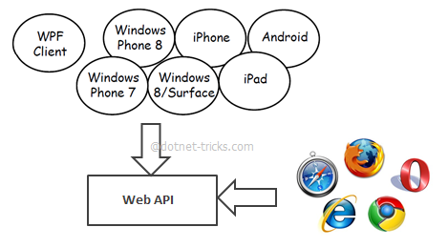
Why Web API?
If you like to expose your service data to the browsers and as well as all these modern devices apps in fast and simple way, you should have an API which is compatible with browsers and all these devices.

Slide 28
Why Web API?
First-class modern HTTP programming model
Easily map resources to URIs and implement the uniform interface of HTTP
Rich support for formats and HTTP content negotiation
Enable hypermedia and link generation – HATEOAS (Hypermedia as the Engine of Application State)
Separate out cross cutting concerns
Flexible hosting
Light-weight, testable, scales

Slide 29
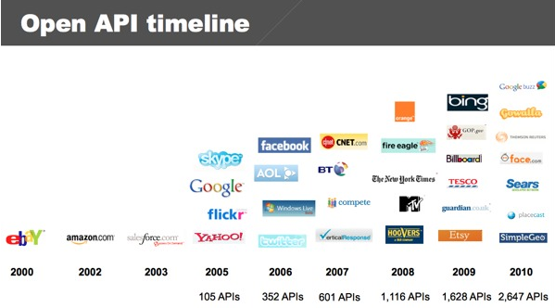
Web API Growth
Source: www.programmableweb.com – current APIs: 10720

Slide 30
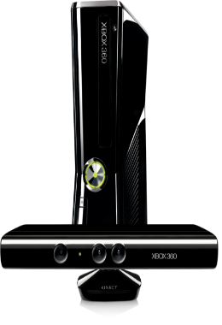




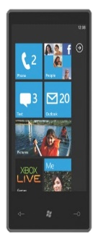
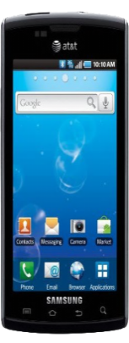
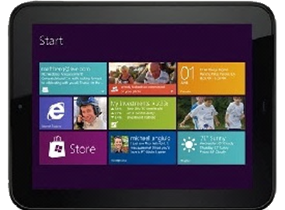

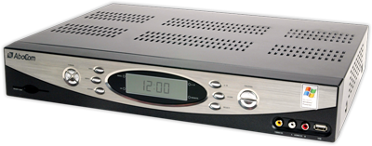


Why Build Web API?
Reach More Clients

Slide 31

Why Build Web API?
Scale with the Cloud

Slide 32
Why Build Web API?
Embrace HTTP
GET /api/dummy/?name=MyName&married=not+single &male=yes HTTP/1.1
Host: www.explainth.at
User-Agent: Mozilla/5.0 (Windows;en-GB; rv:1.8.0.11) Gecko/20070312 Firefox/1.5.0.11
Accept: text/xml,text/html;q=0.9,text/plain;q=0.8,image/png,*/*;q=0.5
Accept-Language: en-gb,en;q=0.5
Accept-Encoding: gzip,deflate
Accept-Charset: ISO-8859-1,utf-8;q=0.7,*;q=0.7
Keep-Alive: 300
Connection: keep-alive
Referer: http://www.explainth.at/en/misc/httpreq.shtml

Slide 33
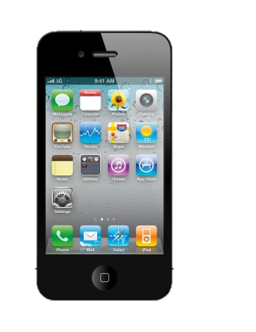

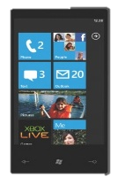

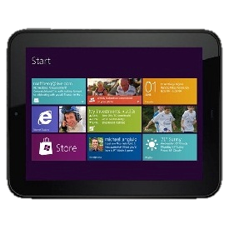
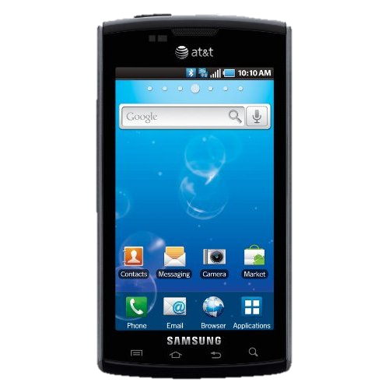
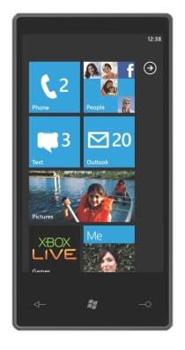

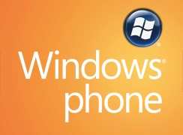

Build Richer Apps
Reach More Clients

Slide 34
RESTful Services?
REpresentational State Transfer
URIs – can access all components via direct URI
Uniform Interface - GET (Retrieve), POST (Create), PUT (Update), DELETE (Delete)
Stateless – No state / context between requests.
Hypermedia (links) – allows expansion and navigation
Cache-ability – certain verb types define themselves as cacheable
*REST is a style, SOAP is a protocol

Slide 35
REST = REpresentational State Transfer
HTTP Verb | Entire Collection (e.g. /customers) | Specific Item (e.g. /customers/{id})
GET | 200 (OK), list of customers. Use pagination, sorting and filtering to navigate big lists. | 200 (OK), single customer. 404 (Not Found), if ID not found or invalid.
PUT | 404 (Not Found), unless you want to update/replace every resource in the entire collection. | 200 (OK) or 204 (No Content). 404 (Not Found), if ID not found or invalid.
POST | 201 (Created), 'Location' header with link to /customers/{id} containing new ID. | 404 (Not Found).
DELETE | 404 (Not Found), unless you want to delete the whole collection—not often desirable. | 200 (OK). 404 (Not Found), if ID not found or invalid.

Slide 36
REST
Focus on Resources and Representations instead of remote objects and operations
REST is an architectural style, SOAP is a protocol
Based on Ph.D. thesis: Roy Fielding
REST fully embraces HTTP
Service address
URI
Resource
Parameters
Payload
Media
Types
HTTP Body
Operation
(POST,GET,PUT,DELETE)
HTTP Verb
Hypermedia
Content Negotiation
Status Codes
HTTP Headers
Security, Etags, etc.

Slide 37
REST Architectural Constraints
Client-Server
Stateless
Cache
Layered Architecture
Uniform Interface
Code On Demand

Slide 38
Uniform Interface
Identification of resources
URIs
Manipulation of resources
HTTP Verbs
Representations
URI/Query string parameters
Self-descriptive messages
Media types
Hypermedia as the engine of application state (HATEOAS)
Links identify related resources and available actions on the current resource
Analogous to a service contract in SOA

Slide 39
URI Design
Service location
Resource
Parameters for manipulating the resource
URL parameters or query string parameters
http://somesite.org/ResourceName/resourceId
http://somesite.org/ResourceName/ChildResource/resourceid/param
http://somesite.org/ResourceName?param1=a&param2=b

Slide 40
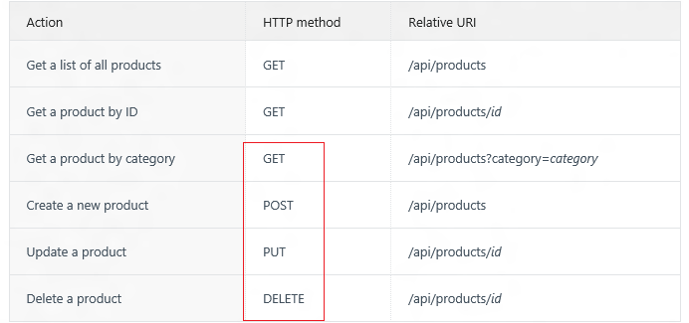
HTTP

Slide 41

URI‘s: Don’t
/api/GetTeams
/api/GetTeam?id=1
/api/GetPlayersByTeam?id=1
/api/AddTeam
/api/UpdateTeam
/api/DeleteTeam?id=1

Slide 42
URI‘s: Do
GET /api/teams
GET /api/teams/1
GET /api/teams/1/players
POST /api/teams
PUT /api/teams/1
DELETE /api/teams/1

Slide 43
HTTP Services
URI for service address + operation + parameters
HTTP protocol
Verbs, headers, caching, status codes
Content negotiation
Accept / Content-Type headers
Media types
HTTP Body
Contains representations of requested resource

Slide 44
Hypermedia-driven services
Client only knows one URI
Representations in responses contain hypermedia links
Links to related resources
Action links to transition the resource to a new state
Indicate allowable actions (operations) for that client for that resource for that point in time

Slide 45
Consuming REST APIs
No metadata standard
No code generated proxies
Theory:
Client only needs to know single root URI
Reality:
Still need out-of-band information on media types and verbs

Slide 46
Consuming REST / Web APIs in .NET
Old school
WebClient / HttpWebRequest
New: HttpClient class
Available in .NET 4 / 4.5 and WinRT
Async methods for GET, PUT, POST, DELETE
Supports content negotiation
Sample pluggable formatters as the server side
Serializes strongly typed payload objects

Slide 47
Consuming REST/Web APIs in JavaScript
Jquery, AngularJS, etc - AJAX
URL
Method (verb)
Content Negotiation (Accept/Content-Type headers)
Handles JSON payloads natively
Avoid XML

Slide 48
Hosting
Web.
ASP.NET & IIS
Self hosting.
Any .NET application can become a Web API server
In Memory.
Whole pipeline in memory
OWIN (Open Web Interface for .NET).
Decouple web application from the host.

Slide 49
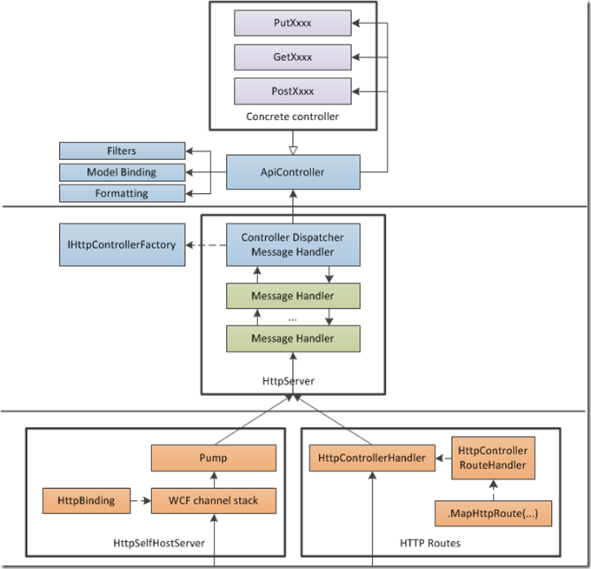
ASP.NET Web API Processing Architecture

Slide 50
Web API Dispatcher
An Illustration of

Slide 51
Web API dispatcher
Invoke action
Action filters
Parameter binding
Authorization filters
Select action
Exception filters
Route to controller
Formatting
HttpRequestMessage
HttpResponseMessage

Slide 52
Web API dispatcher
Invoke action
Action filters
Parameter binding
Authorization filters
Select action
Exception filters
Route to controller
Formatting
HttpRequestMessage
HttpResponseMessage

Slide 53
Implementing Web API actions
Web API actions map to HTTP methods
Prefix your action name with the desired HTTP method
Ex GetCustomer, PostComment, DeleteOrder, etc.
Use [HttpGet/Post/Put/Delete] if you prefer a different name
Overload actions based on the presence of data in the URI
Note: Action selection can also be done using the {action} route variable just like MVC
IEnumerable<Customer> Get() {…}
Customer Get(int id) {…}

Slide 54
Web API dispatcher
Invoke action
Action filters
Parameter binding
Authorization filters
Select action
Exception filters
Route to controller
Formatting
HttpRequestMessage
HttpResponseMessage

Slide 55
Web API dispatcher
Invoke action
Action filters
Parameter binding
Authorization filters
Select action
Exception filters
Route to controller
Formatting
HttpRequestMessage
HttpResponseMessage

Slide 56
Action parameters
Simple parameter types are taken from the URI
Route data, query parameters
Complex parameter types come from the body (only one)
Configured MediaTypeFormatters (formatters) are used to deserialize the request body based on the content type
JSON, XML, and form–url–encoded supported by default
Override using [FromUrl], [FromBody], [ModelBinder], custom parameter binding
You can always work with HttpRequestMessage directly

Slide 57
Parameter validation
Validation is run on the bound parameters
Specify validation rules using DataAnnotations or custom validation logic
Validation errors are accumulated in the ModelState
Check ModelState.IsValid
Send back validation errors to client using Request.CreateErrorResponse(ModelState)

Slide 58
Web API dispatcher
Invoke action
Action filters
Parameter binding
Authorization filters
Select action
Exception filters
Route to controller
Formatting
HttpRequestMessage
HttpResponseMessage

Slide 59
Web API dispatcher
Invoke action
Action filters
Parameter binding
Authorization filters
Select action
Exception filters
Route to controller
Formatting
HttpRequestMessage
HttpResponseMessage

Slide 60
Web API dispatcher
Invoke action
Action filters
Parameter binding
Authorization filters
Select action
Exception filters
Route to controller
Formatting
HttpRequestMessage
HttpResponseMessage

Slide 61
Response formatting and content negotiation
Returned object is serialized in the response body using configured formatters
Request indicates preferred format using the accept header
Server selects a format for the response based on the request, action return type, configured formatters
You can always just return HttpResponseMessage directly

Slide 62
Web API dispatcher
Invoke action
Action filters
Parameter binding
Authorization filters
Select action
Exception filters
Route to controller
Formatting
HttpRequestMessage
HttpResponseMessage

Slide 63
Filters
Used to handle cross cutting concerns
Action filters run before and after invoking an action
Authorization filters run before model binding and are specifically for authorizing the user
Exception filters handle generating responses for error cases in a centralized way
Configured globally, per controller, or per action as an attribute (ex [Authorize])

Slide 64
Building ASP.Net Web API
File -> New Project
With MVC 5.0

Slide 65
API with ASP.NET Web API
Create a controller.
ApiController, IHttpController
Add actions.
Return models / HttpResponseMessage / IHttpActionResult
Add routes.
Centralized or attribute-based
Use message handlers / filters.
Cross-cutting concerns

Slide 66
Controllers
Represents a HTTP resource
Doesn’t have to map 1-to-1 to an entity!
ApiController provides lots of helpers
Helps you conform to HTTP standards
Can be loaded from other assemblies
Use IAssembliesResolver

Slide 67
Actions
Actions handle HTTP request
Maps to an incoming HTTP request
HTTP verb dispatching (RESTful)
Actions matched:
- by prefix (GetAll, GetById)
- by action attribute (i.e. [HttpPost])
RPC not encouraged, but supported

Slide 68
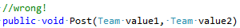
Actions parameters
From URI - primitives
Int, string etc From querystring or route data
From Body - complex types
Use MediaTypeFormatters
Only one thing can be read from body
Customizable
[FromUri], [FromBody], custom parameter binding

Slide 69
Action return
Model / void
Any CLR type
HttpResponseMessage
Work with HTTP concepts directly
IHttpActionResult
Predefined factories creating HttpResponseMessage
public interface IHttpActionResult
{
Task<System.Net.Http.HttpResponseMessage> ExecuteAsync(CancellationToken cancellationToken);
}

Slide 70
Sample Read-only Model and Controller
Step 1:
Create a Model
public class Person
{
public int Id { get; set; }
public string Name { get; set; }
}
Step 2:
Make an API Controller
public class PersonController : ApiController
{
List<Person> _people;
public PersonController()
{
_people = new List<Person>();
_people.AddRange(new Person[]
{
new Person { Id = 1, Name = "Chuck Norris" },
new Person { Id = 2, Name = "David Carradine" },
new Person { Id = 3, Name = "Bruce Lee" }
});
}
}

Slide 71
Read-only Controller Actions to return data
Step 3:
Return everything
// GET /api/person
public IEnumerable<Person> Get()
{
return _people;
}
Step 4:
Return one item
// GET /api/person/5
public Person Get(int id)
{
return _people.First(x => x.Id == id);
}

Slide 72
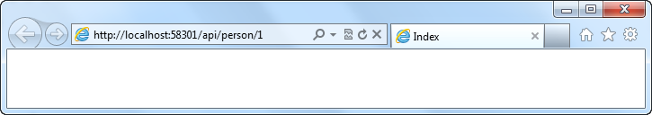
Routing a Web API Using Global.asax.cs
Routing:
Familiar syntax, conventional approach
public static void RegisterRoutes(RouteCollection routes)
{
routes.MapHttpRoute(
name: "DefaultApi",
routeTemplate: "api/{controller}/{id}",
defaults: new { id = RouteParameter.Optional }
);
}

Slide 73
Manipulating HTTP Responses
Return HttpResponseMessage<T> to modify response headers
Example
Find a person and return it, but what happens if we don’t find a match?
// GET /api/person/5
public HttpResponseMessage<Person> Get(int id)
{
try
{
var person = _people.First(x => x.Id == id);
return new HttpResponseMessage<Person>(
person,
HttpStatusCode.OK
);
}
catch
{
return new HttpResponseMessage<Person>(HttpStatusCode.NotFound);
}
}

Slide 74
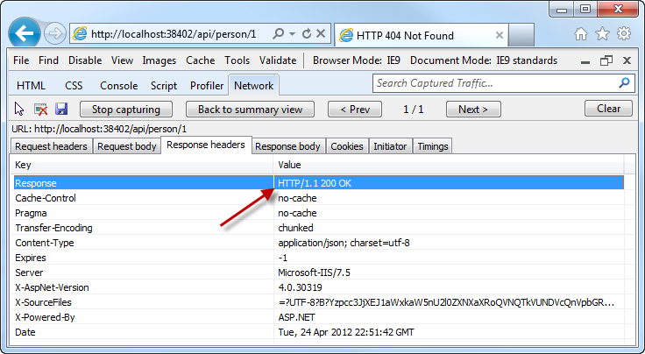
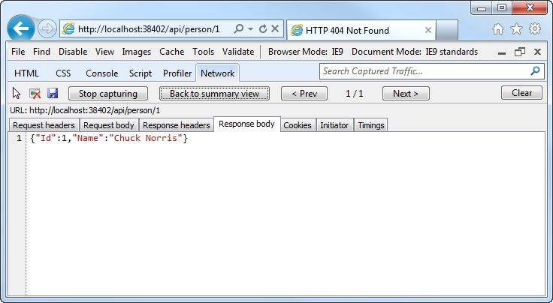
Manipulating HTTP Responses
A successful API call returns an HTTP OK and the JSON data

Slide 75
Posting Data to a Web API
Use HTTP Post:
Pass a Model
public HttpResponseMessage Post(Person person)
{
person.Id = _people.Count + 1;
if (_people.Any(x => x.Id == person.Id))
return new HttpResponseMessage(HttpStatusCode.BadRequest);
try
{
_people.Add(person);
}
catch
{
return new HttpResponseMessage(HttpStatusCode.BadRequest);
}
return new HttpResponseMessage(HttpStatusCode.OK);
}

Slide 76
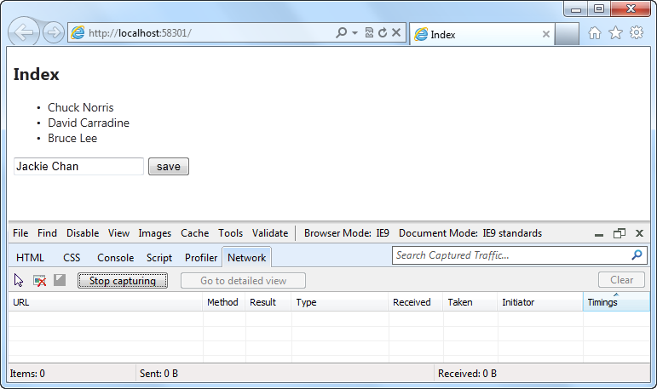
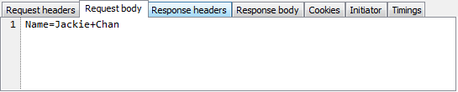
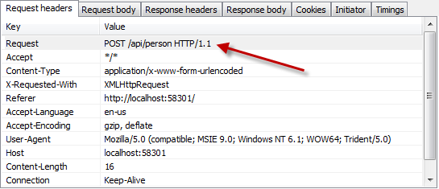
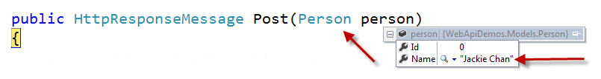
Posting Data to a Web API

